Slide 1
How Can We Build Dynamic Web Application

Slide 2
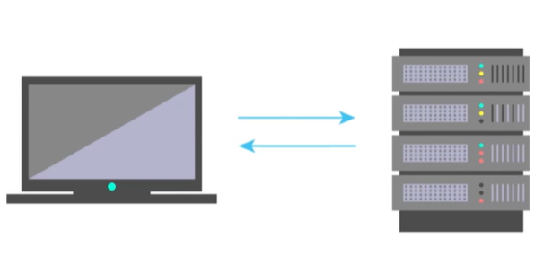
Dynamic Web Applications Building Process
Building Dynamic Web Applications mainly involves:
Client Server Communication
Manipulating HTML and CSS
Writing Application Logic

Slide 3

Ways to achieve above three things
Using JavaScript
Using Web Assembly

Slide 4

Introduction to JavaScript why JavaScript?
JavaScript is the most popular programming language which is adopted and understand by the all the major browsers

Slide 5
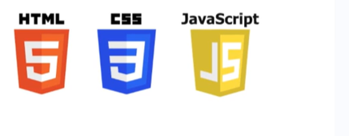
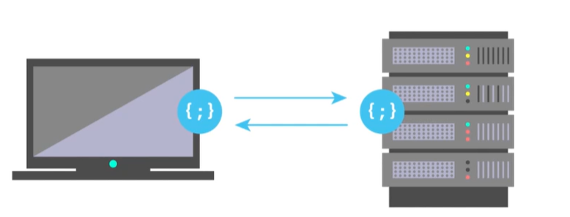
JavaScript(JS)
HTML provides the basic structure for web pages.
CSS is used for styling.
JS is used primarily by web browsers
to create a dynamic and interactive
experience for the users.
Java Script can be used in both client-side and server-side.

Slide 6

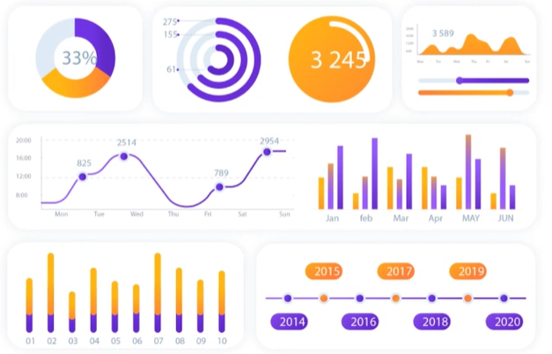

JavaScript Applications
1.Button Animations 2.Live Dashboards 3.Games

